Slide 1
WEEK 10 PRESENTATION AIRFRAME
BY VIVIAN MWANGI &
MARK ODHIAMBO

Slide 2
TASKS COMPLETED THIS WEEK
RECOVERY SYSTEM FABRICATION #137
MATERIAL ACQUISITION(RESIN) &CONSUMABLES #116
3D PRINT NOSE CONE #115
FOURTH BODY TUBE FABRICATION #152

Slide 3
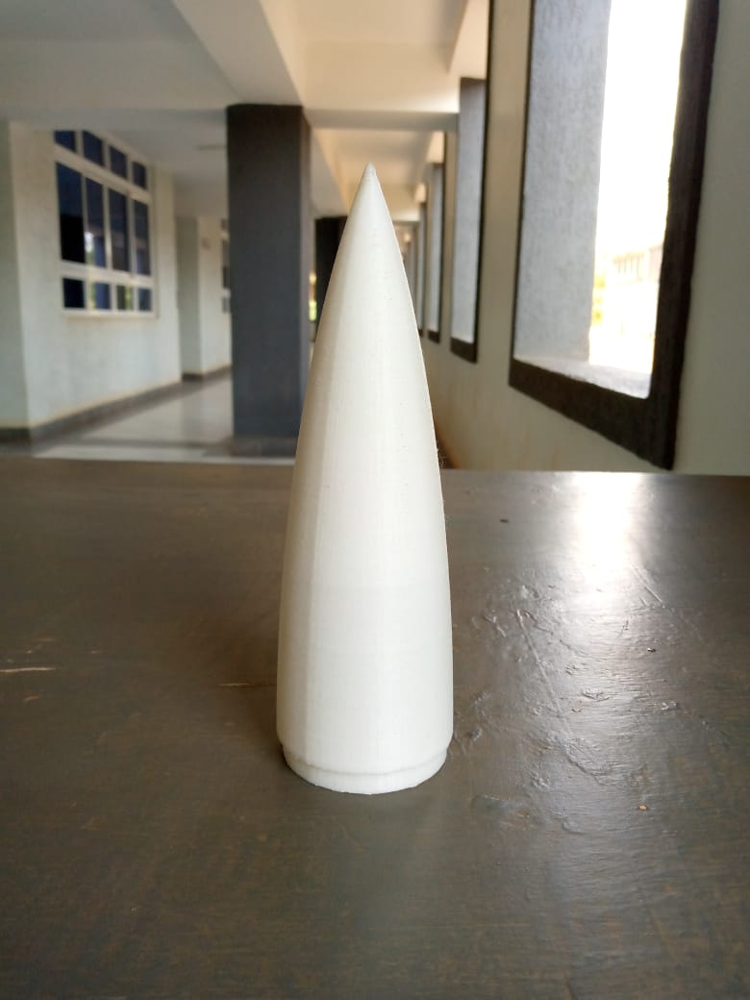
3D PRINT NOSE CONE #115

Slide 4
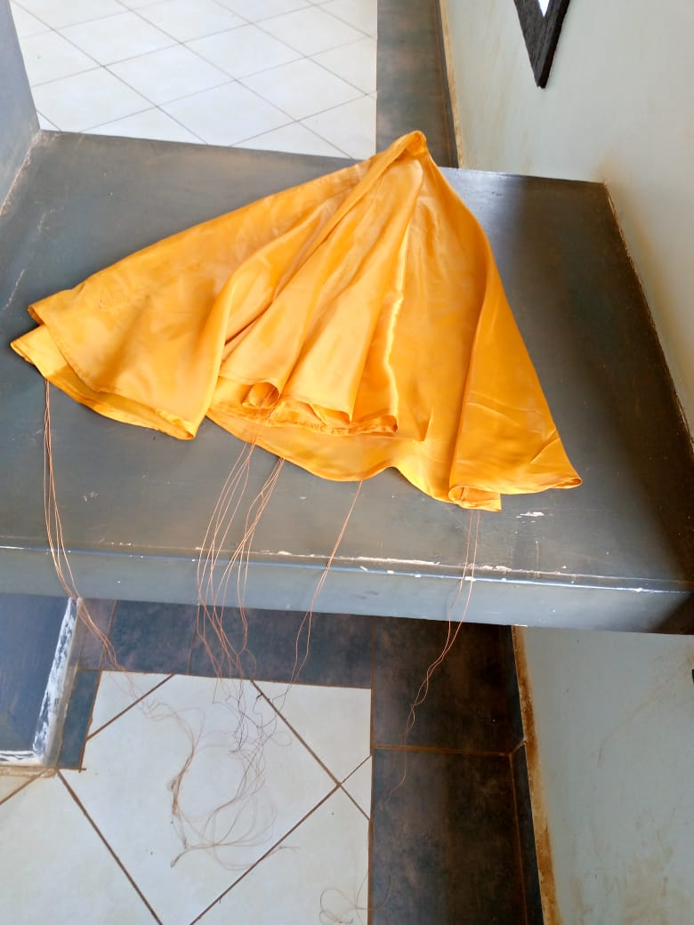
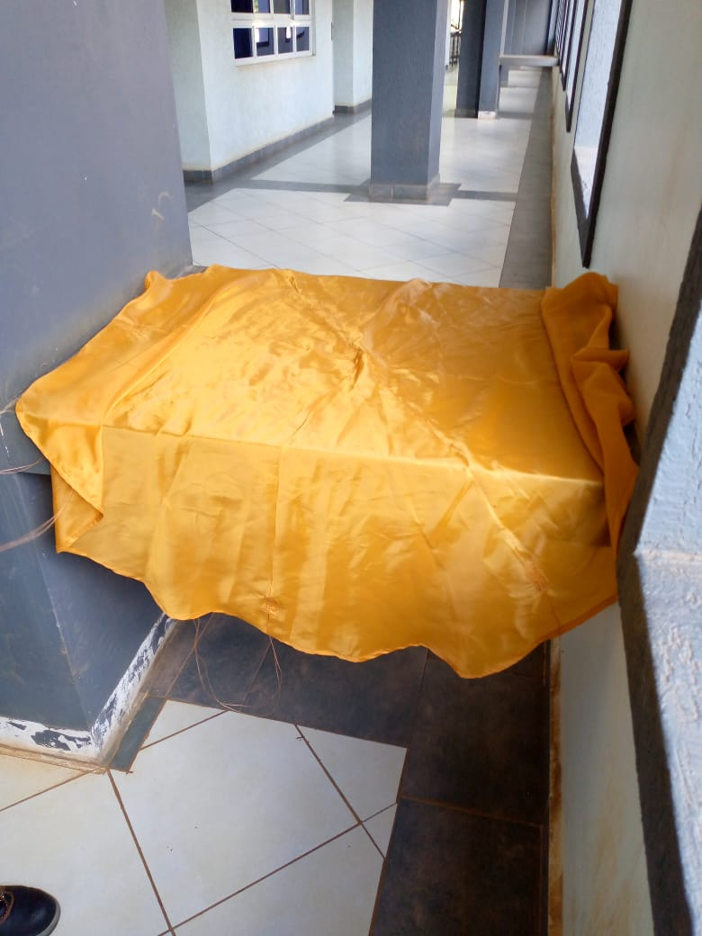
RECOVERY SYSTEM FABRICATION #137
Parachute model was tailored to the required dimensions

Slide 5
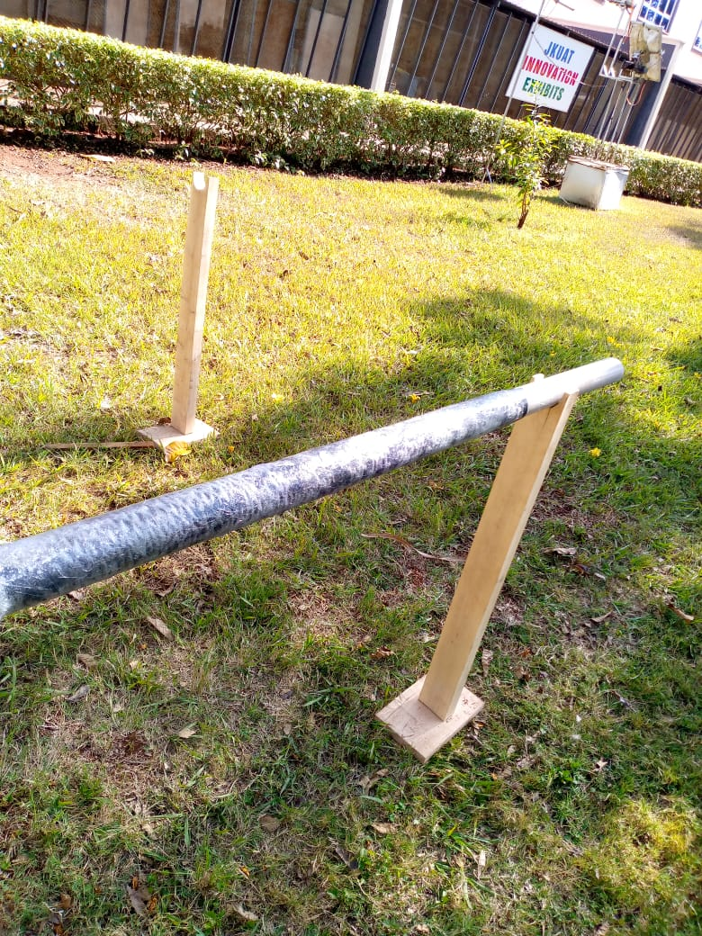
FOURTH BODY TUBE FABRICATION #152
Improvements made:
Less air bubbles
Measurements taken into account

Slide 6
TASKS IN THIS WEEK
FIN SET FABRICATION #139
NOSE CONE FABRICATION #138
RECOVERY SYSTEM TESTING #153
TEST LAUNCH #111

Slide 7
THANK YOU! -THE END-

